Slide 1
Mid-semester Presentation
Smart Crosswalk Dynamic Lighting System
Senior Design II – Fall 2015

Slide 2
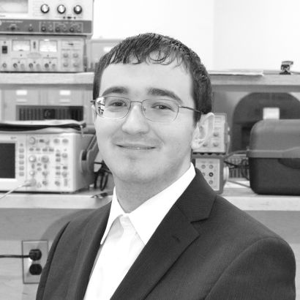
Team Members
Emily Dance
Hagan Walker
Lee Sargent
George Hilliard
Preston Stinson
Team Leader
Electrical Engineering
Electrical Engineering
Electrical Engineering
Computer Engineering
Electrical Engineering

Slide 3
Advisor
Dr. Robert Reese
Research interests
Asynchronous design
Computer architecture
High-level system synthesis
Phased logic
VLSI CAD frameworks
VHDL modeling

Slide 4
Outline
Problem
Solution
System Overview
Teaming
Project Concerns
Testing
Product Refinements
Packaging
Progress
Questions
Smart Crosswalk Dynamic Lighting System

Slide 5
The Problem
4000+ pedestrians per year were killed in traffic accidents from 2003 to 2012
Pedestrians are at a high risk of vehicular injury on crosswalks
Few laws pertaining to crosswalk safety
Smart Crosswalk Dynamic Lighting System

Slide 6
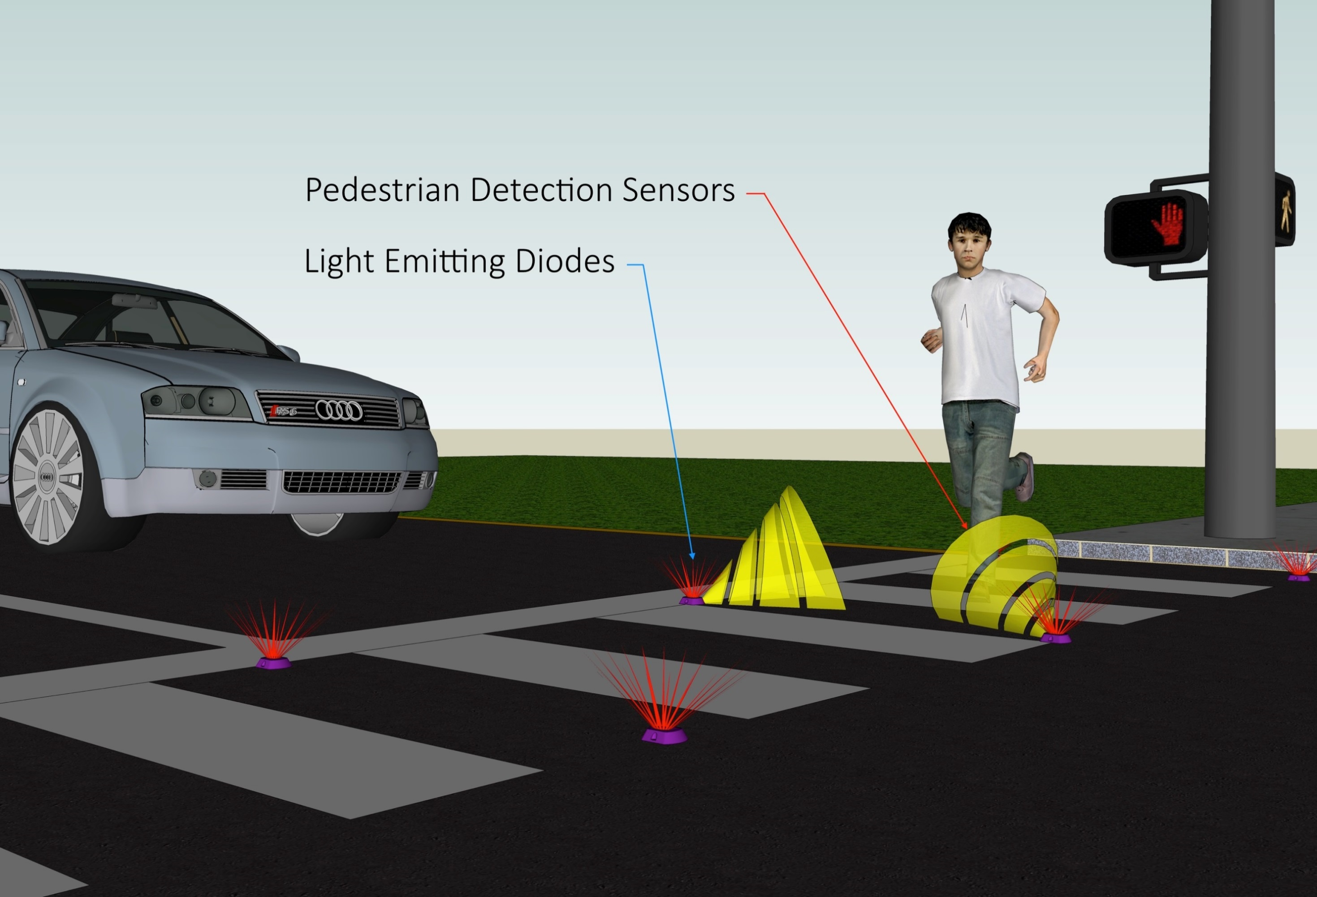
The Solution
LEDs light up crosswalk as pedestrian enters crosswalk
LEDs alert oncoming vehicles when crosswalk in use

Slide 7
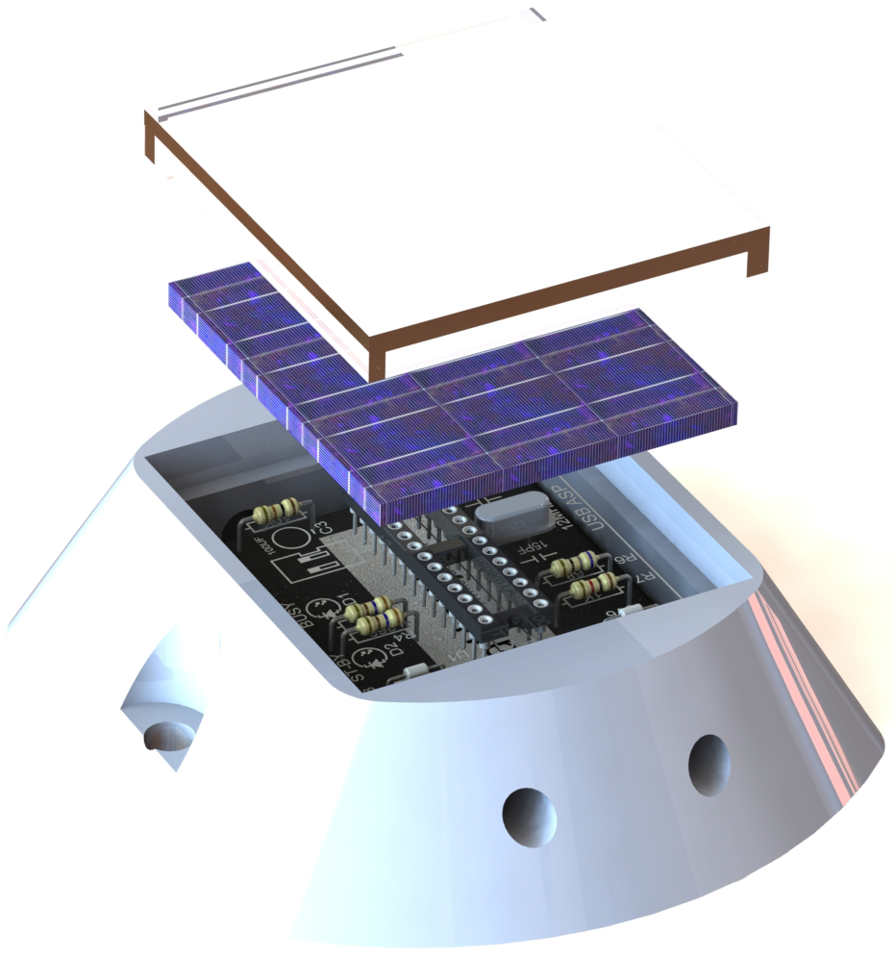
Product Overview
Polycarbonate Casing
Solar Panel
Aluminum Casing
Atmel 328P
LED Lighting
For illustrative purposes only.

Slide 8
Technical Constraints
Name | Description
Solar Generation | The solar panel must provide an average of 1.4 kJ/day.
Battery Life | The module must consume less than 1.3 kJ/day on average.
Module to Module Communication | Modules must be able to communicate wirelessly with one another at a distance of 10 meters or greater.
Wi-Fi Communication | Modules must be able to upload traffic analytics to a remote web server.
PIR Motion Detector | This component must be able to accurately detect pedestrians at a distance of 16 feet or less.
Magnetometer | This component must be able to detect a car at speeds of 5mph or greater.
LED Driver | This component must be able to power two or more LEDS and utilize the I²C bus for communication.
3.3V Switching Regulator | This component must be able to output a steady 3.3V

Slide 9
Practical Constraints
Manufacturability
Health and Safety

Slide 10
SCDLS Casing Manufacture
SCDLS Casing
Aluminum
Durable
Machine-able
Quotes Received
[2]
Lee and Hagan
Notes:
For manufacturability, finding a suitable material for the casing was important. The team chose aluminum because it can be easily fabricated. In addition, PCB packaging is constrained based on the size of each unit, therefore, it was important to find smaller components.

Slide 11
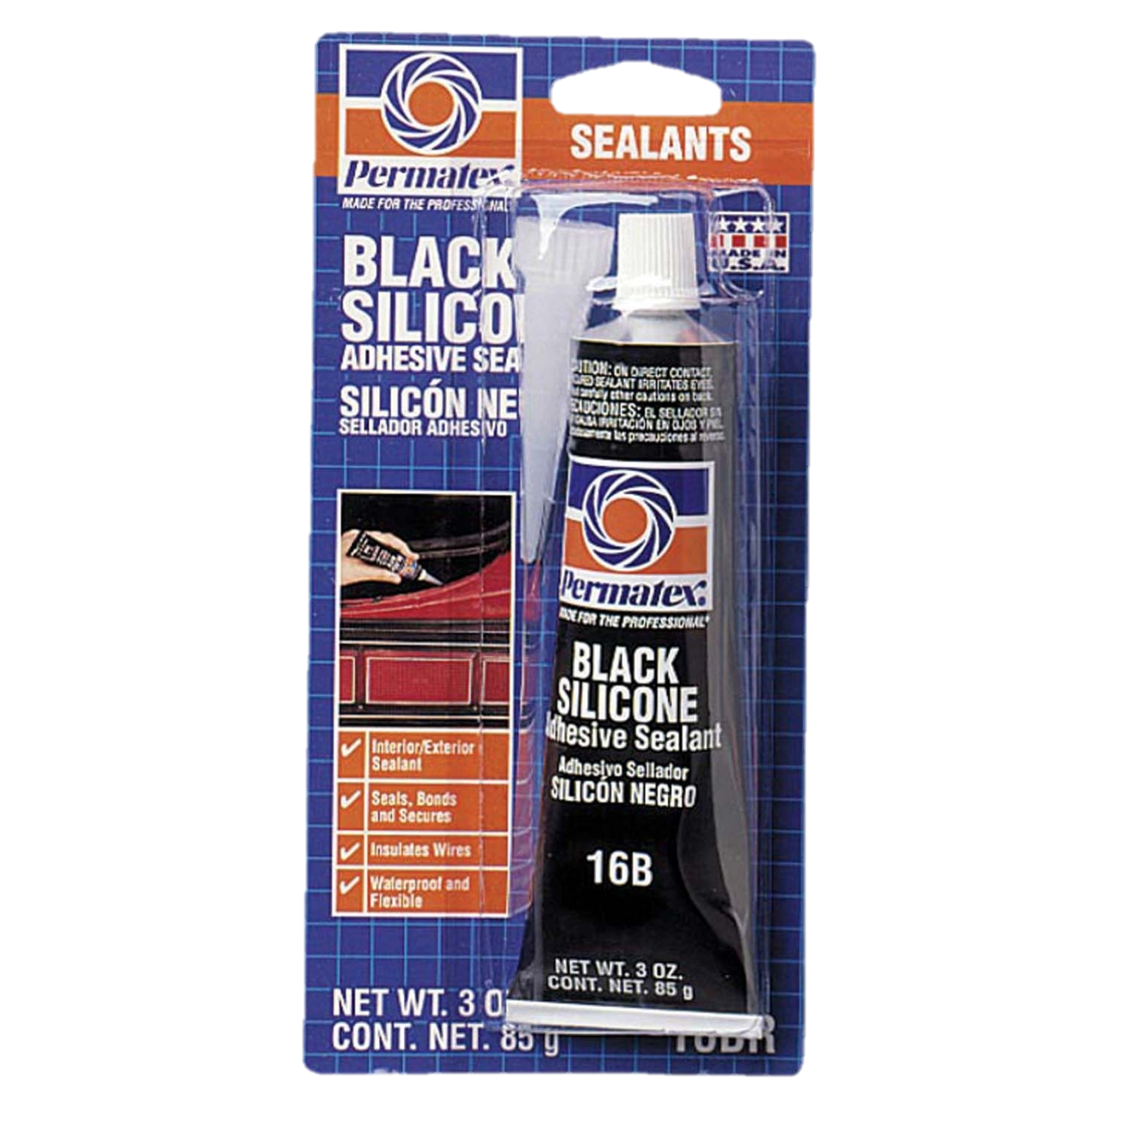
Manufacture for Ingress Protection
Solid and Liquid Protection
Seal solar panel, and access port
Coat PCB and battery
[3]
[4]
Lee and Emily
Notes:
For manufacturability, finding a suitable material for the casing was important. The team chose aluminum because it can be easily fabricated. In addition, PCB packaging is constrained based on the size of each unit, therefore, it was important to find smaller components.

Slide 12
SCDLS PCB Manufacture
Selected PCB Manufacturer
0.6mm thickness
Approximately 10 boards for $12
[5]
Preston and Hagan
Notes:
Around 10 boards for 12 dollars .6mm
67mm x 48mm

Slide 13
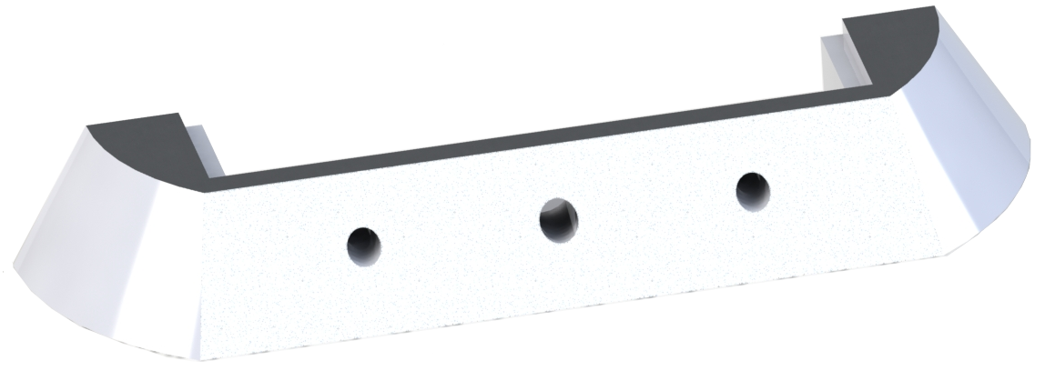
Health and Safety
Hazards to Avoid
Tripping hazards
Puncturing Vehicle Tires
LED Blinding
Notes:
To avoid the hazards listed above, the modules must be low enough to the ground to avoid tripping. Also they must not consist of sharp edges that can puncture tires. Lastly, LEDs must not be overly bright as to not blind drivers at night.

Slide 14
Product Testing
Solar Panel
Battery Life
3.3V Regulator
PIR Sensors
LED Drivers
NRF24L01+
ESP8266 / Web Server
Subsystem and Module Validation

Slide 15
Technical Constraint Testing
Name | Testing Plan
Solar Generation | Size solar panel appropriately to meet energy requirements.
Battery Life | Choose a battery chemistry and size to meet energy requirements.
Module to Module Communication | Place NRF24L01+ in aluminum housing and find max communication distance.
Wi-Fi Communication | Place ESP8266 in aluminum housing and find max communication distance.
PIR Motion Detector | Place PIR sensor in roadway and measure that pedestrians are accurately detected at 16 feet or less.
Magnetometer | Place magnetometer in roadway and measure fluctuations given by passing vehicles at speeds of 5mph and greater.
LED Driver | Test driver functionality with two LEDs at varying PWM rates to ensure that communication and lights respond appropriately.
3.3V Switching Regulator | Test switching regulator in a variety of environmental situations to ensure no fluctuation occurs on output voltage.

Slide 16
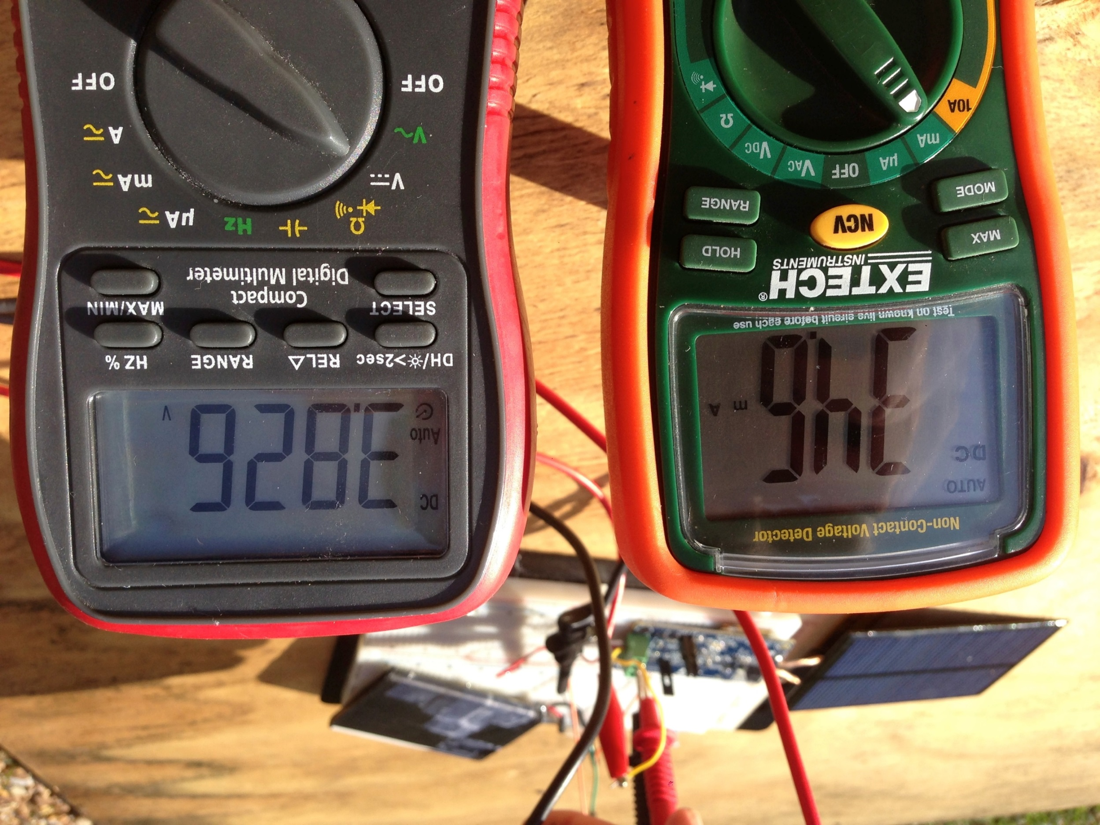
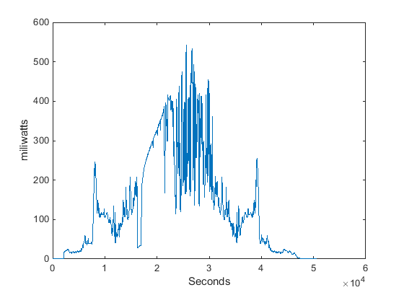
Solar Panel
Working energy harvesting circuit.
Steady output voltage of 3.8V for battery charging applications.
Current fluctuates with sunlight.
Hagan and Lee
Notes:
http://www.discovercircuits.com/DJ-Circuits/Modified_Solar_PathLight.htm

Slide 17
Power Consumption
Lee and Emily
Notes:
http://www.ebay.co.uk/itm/Genuine-Samsung-Battery-B800BE-for-Galaxy-Note-3-N9000-N9005-3200mAh-3-8V-New-/251578215907
http://www.automotivecomposites.com/batteries.htm

Slide 18
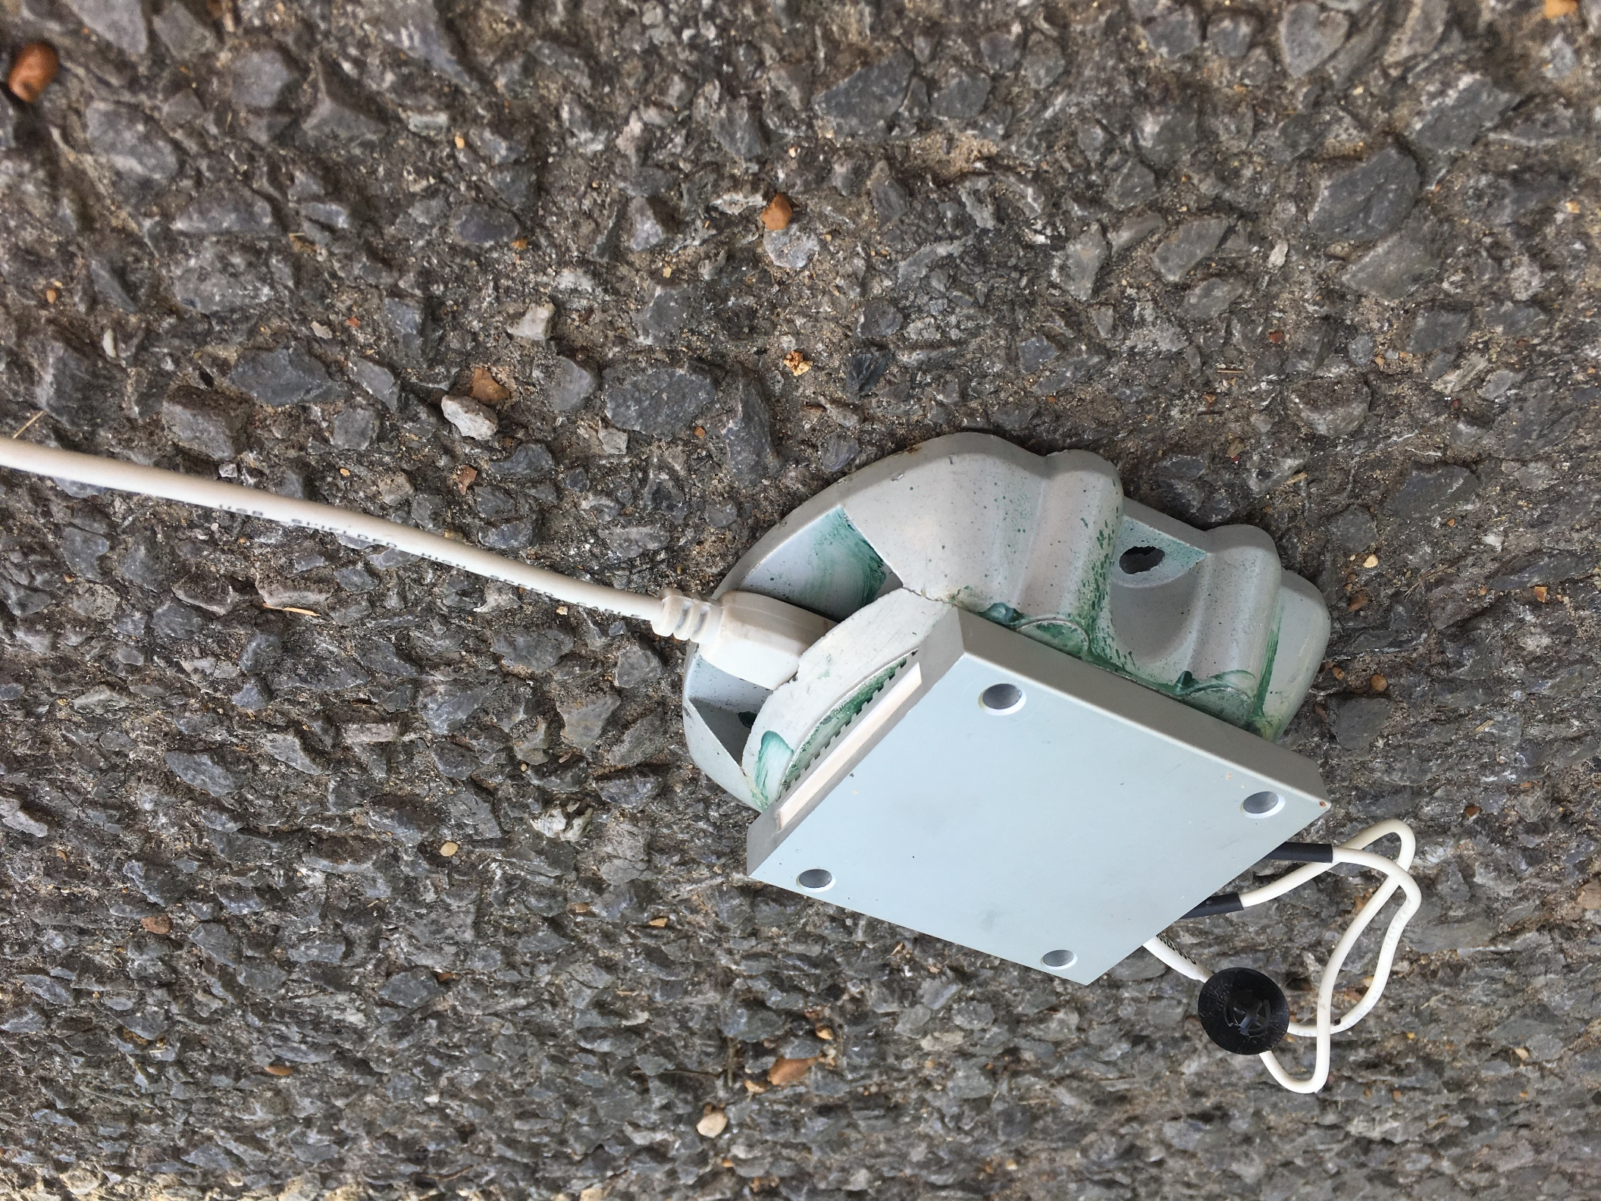
Communication Testing
Wireless modules are placed in aluminum housings and communication is tested by increasing distance.
By watching serial output on a computer, it is easy to see when communication degradation occurs.
Hagan and Lee
Notes:
http://www.ebay.co.uk/itm/Genuine-Samsung-Battery-B800BE-for-Galaxy-Note-3-N9000-N9005-3200mAh-3-8V-New-/251578215907
http://www.automotivecomposites.com/batteries.htm

Slide 19
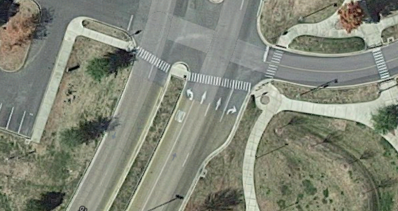
Communication Testing
14m

Slide 20
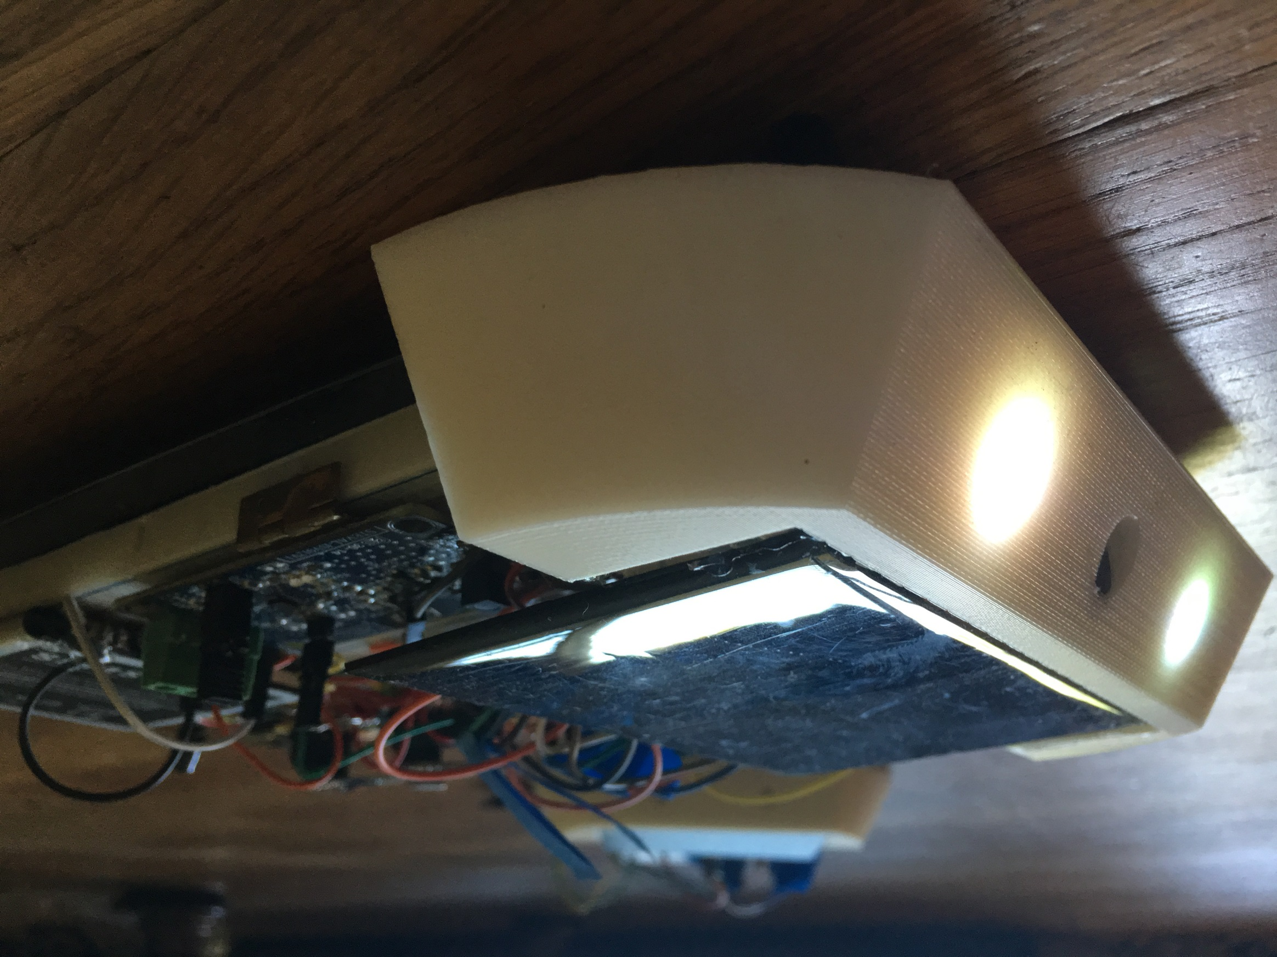
PIR Motion Sensor
To be tested in different environments.
Should function accurately at 16 feet and less.
Sensitivity can be adjusted via software if needed.
Hagan and Lee
Notes:
http://www.ebay.co.uk/itm/Genuine-Samsung-Battery-B800BE-for-Galaxy-Note-3-N9000-N9005-3200mAh-3-8V-New-/251578215907
http://www.automotivecomposites.com/batteries.htm

Slide 21
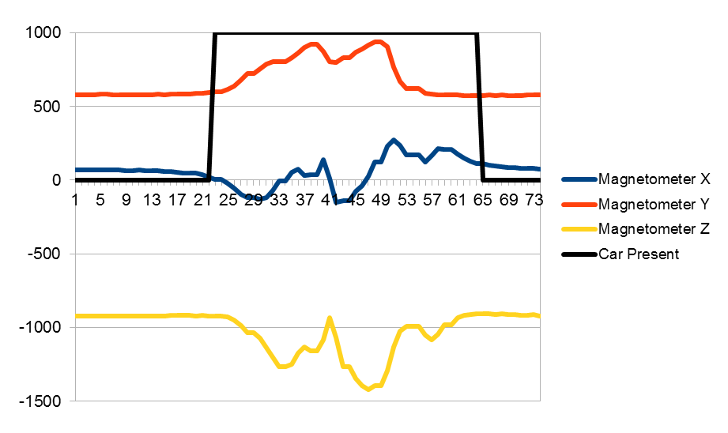
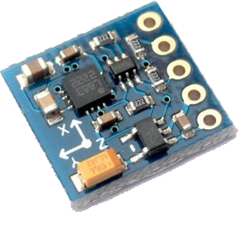
Magnetometer
[4]
George and Hagan
Notes:
http://www.emartee.com/Images/websites/emartee.com/HMC5883L-1.jpg

Slide 22
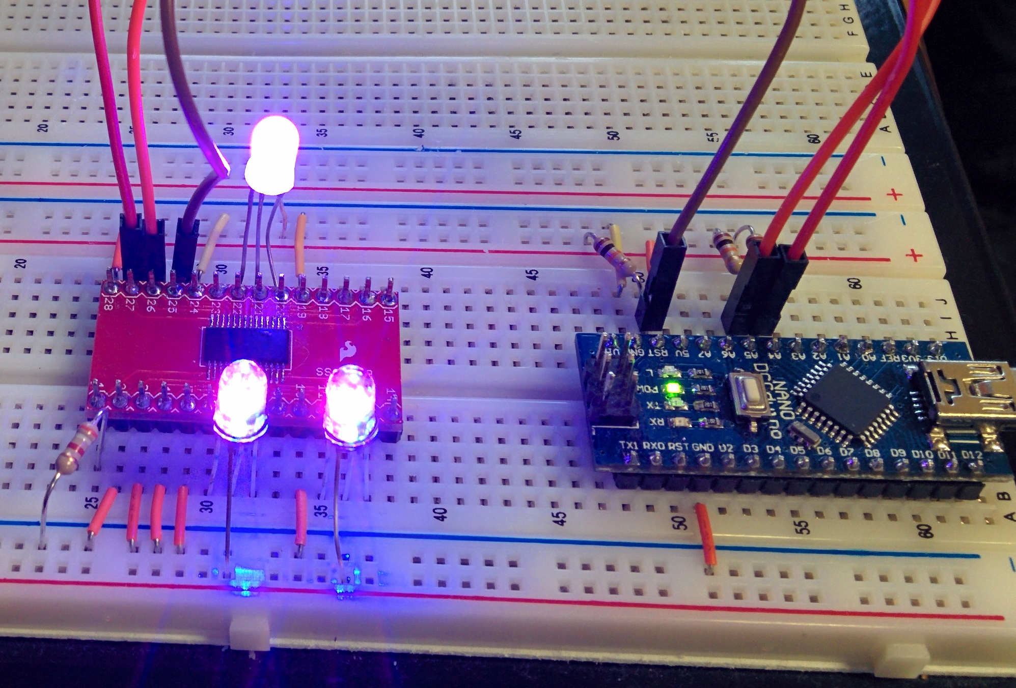
LED Driver
Used I²C communication test to turn on LEDs.
Repeated procedure for seven color combinations.
Four dimming values were also tested.
Preston and George
Notes:
http://www.ti.com/product/lm3670
http://www.st.com/st-web-ui/static/active/en/resource/technical/document/application_note/DM00048561.pdf
http://www.adafruit.com/product/390

Slide 23
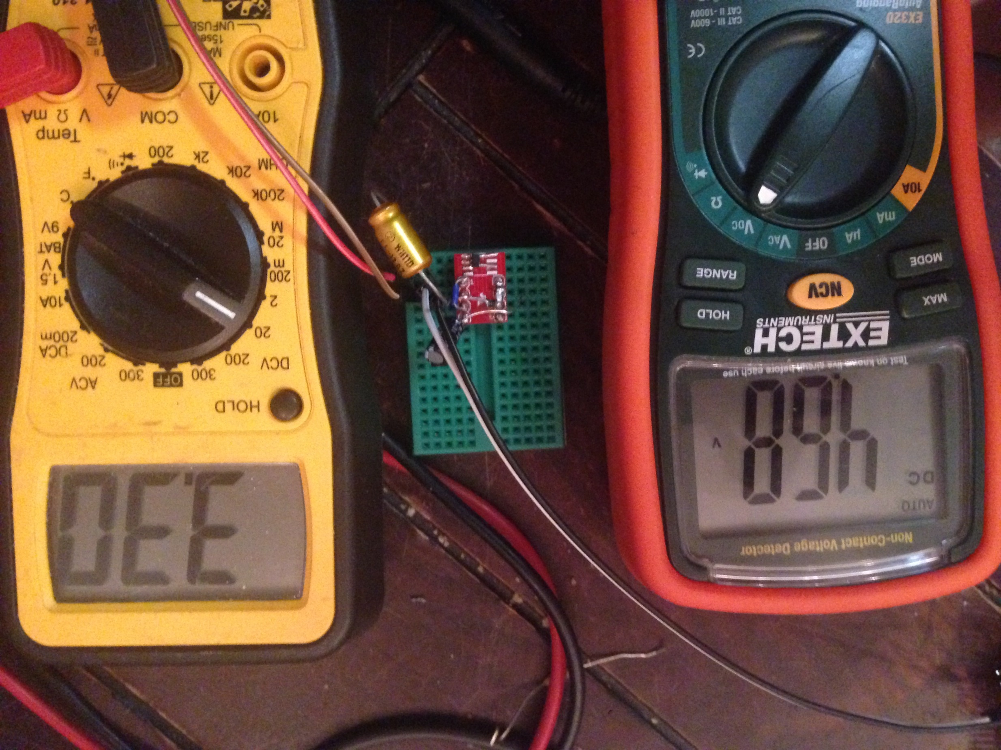
3.3V Regulator
Accepts input from 2.7V to 11.8V
To be tested in a variety of environmental conditions
4.68V on input is regulated to 3.3V on output.
Hagan and Lee
Notes:
http://www.ebay.co.uk/itm/Genuine-Samsung-Battery-B800BE-for-Galaxy-Note-3-N9000-N9005-3200mAh-3-8V-New-/251578215907
http://www.automotivecomposites.com/batteries.htm

Slide 24
Changes
Design I to Design II

Slide 25
Wireless Power Saving
“Lockstep” – Synchronized
Radio Standby
Mode | Current Draw
Send | 14mA
Receive | 12mA
Power-down | 900nA
Standby I | 26µA
Saves power by keeping radios in low-power mode
Schedules “windows” to wake up and transmit/receive
Timers synchronized by periodic signal from master hub

Slide 26
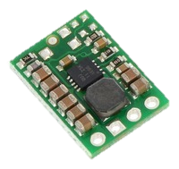
Wi-Fi Power Supply
Allows complete shutdown of power-hungry module
Keeps main power supply within rated current limit

Slide 27
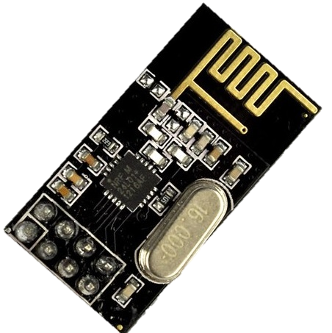
Daughterboards
Pros
Cons
Simpler main schematic
Decreased prototyping and assembly time
Simplified component sourcing
Increased prototype cost
Additional PCBs require more space in casing

Slide 28
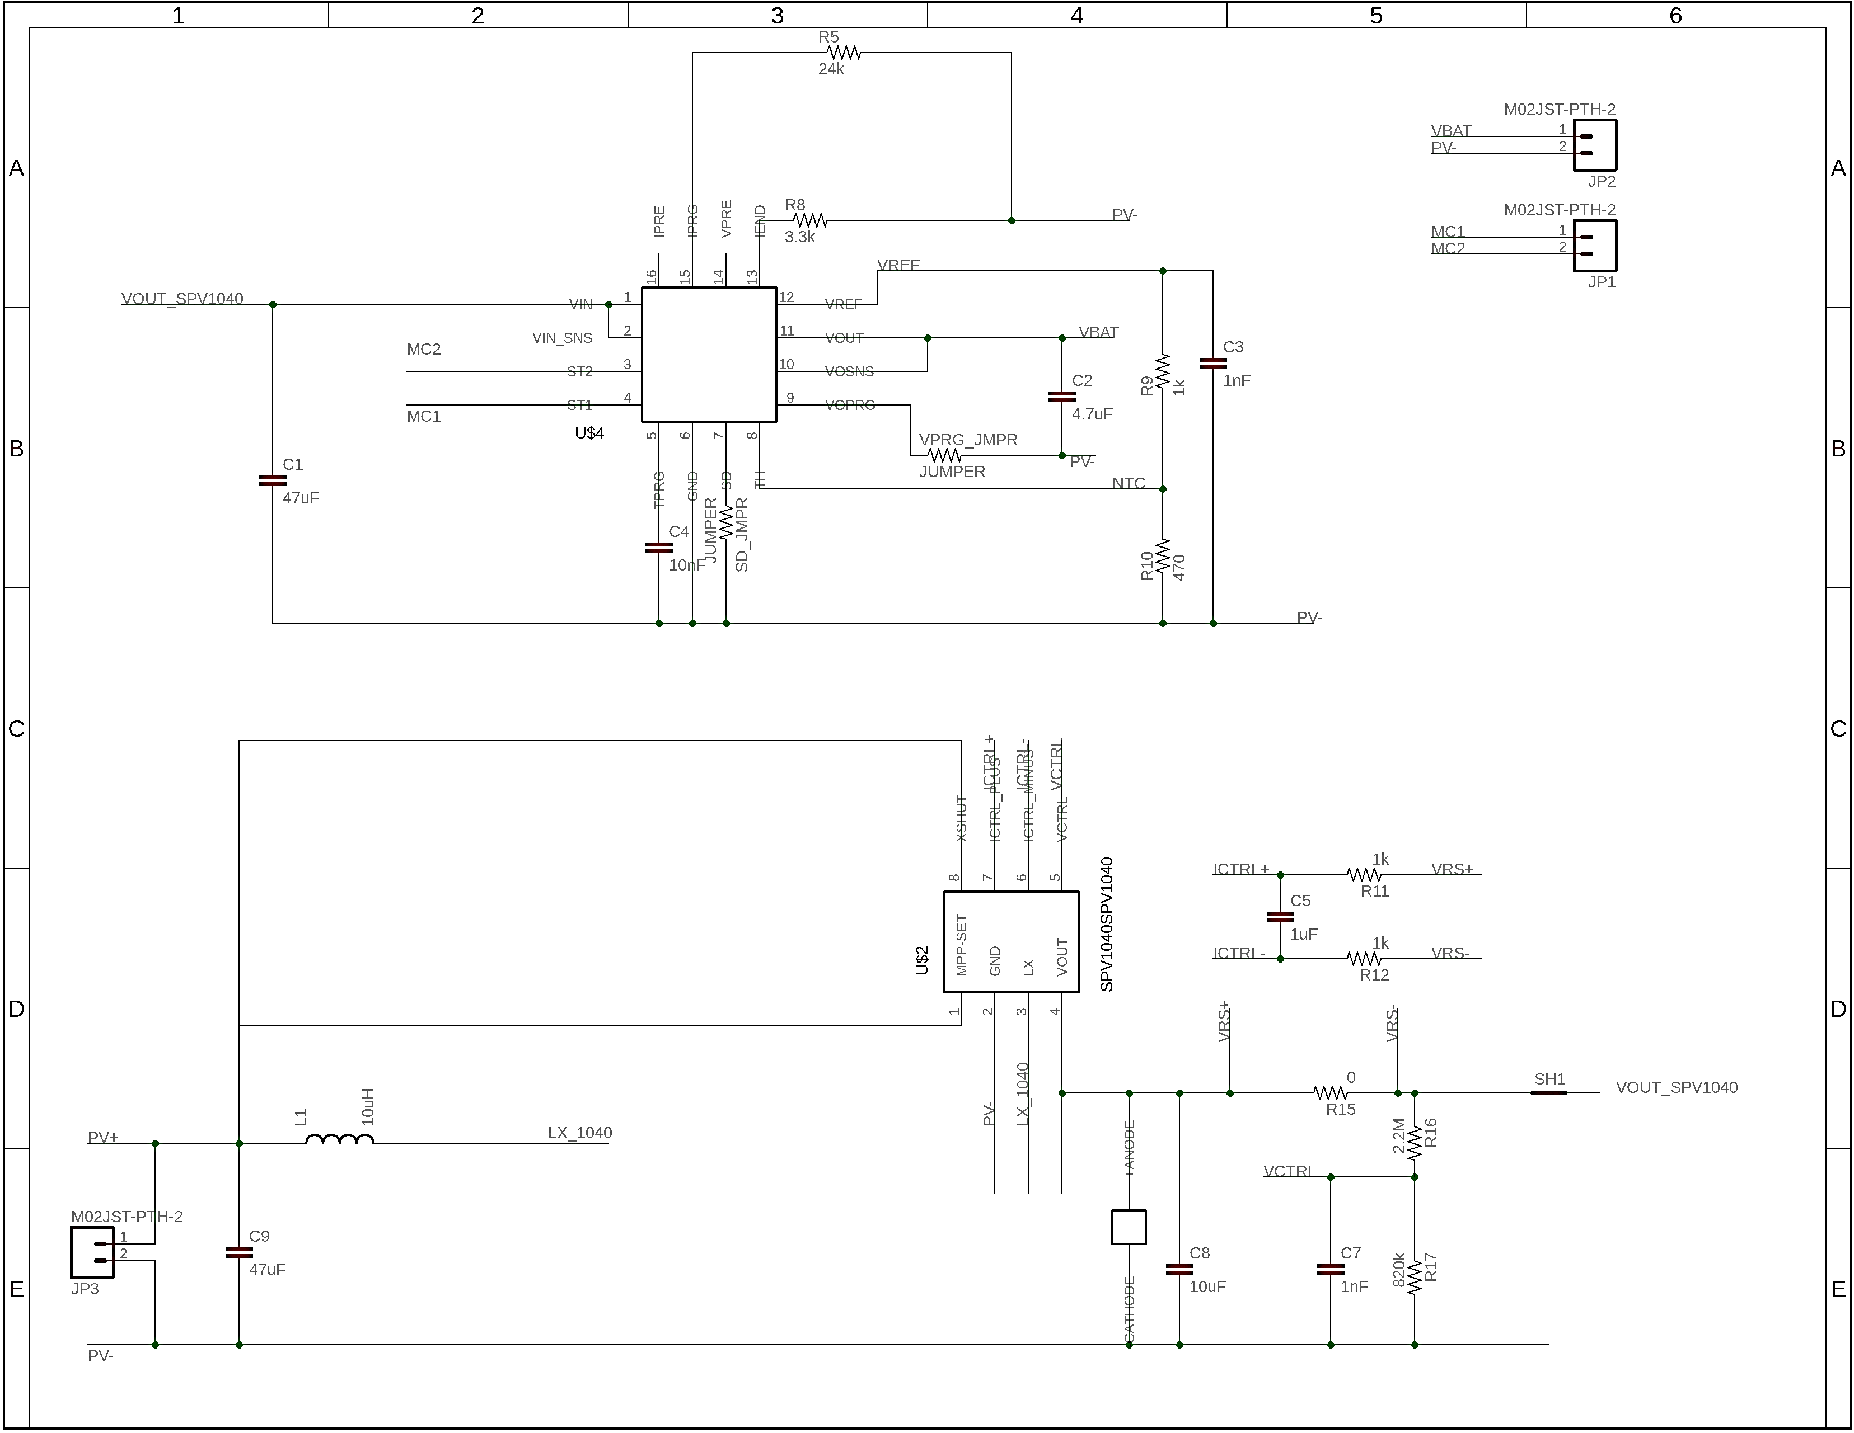
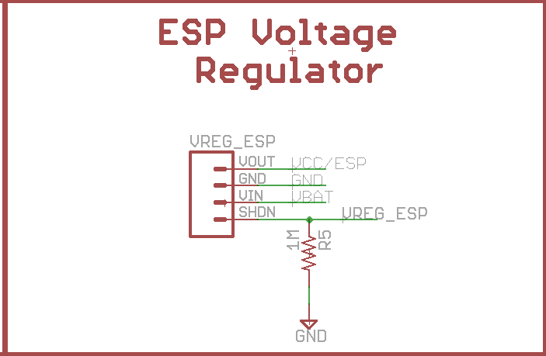
Daughterboards

Slide 29
Packaging
Smart Crosswalk Dynamic Lighting System

Slide 30
PCB
PCB Design
Breakout boards attached to PCB due soldering difficulties
All other components components in TSSOP, TQFP, or 0805 packages
Extra digital I/O pins on the microcontroller broken out to ease expanding capabilities
Render of front of PCB.
Preston and George

Slide 31
PCB
PCB Design
Ground plane used to reduce noise
Traces placed to reduce crosstalk
All pins used on the microcontroller broken out to ease testing and debugging
Render of back of PCB.
Preston and George

Slide 32
Housing
Housing Design
Aluminum used for housing to meet load requirements
Designed for manufacturing on a CNC machine
Quote requested from Proto Labs
For full scale manufacturing casting from mold would be used
3D Render of Housing
Preston and Lee

Slide 33
Housing Interior*
Solar Panel
Main PCB
Solar Charger
Battery
*Not to scale
Preston and Emily

Slide 34
Progress
Smart Crosswalk Dynamic Lighting System

Slide 35
Progress
PCBs ordered
Quote received from Proto Labs
Begun implementing software changes
Hardware changes implemented

Slide 36
Works Cited
[1] Louisiana Record “Steel” [Online]. Available: http://louisianarecord.com/wp-content/uploads/2014/10/Steel-Beam-Sizes-1-300x230.jpg. [Accessed 25 03 2015].
[2] Inventable: Extrusions “Aluminum” [Online]. Available: http://i.ebayimg.com/images/i/330351272615-0-1/s-l1000.jpg. [Accessed 25 03 2015].
[3] Business Wire, ”Panasonic PaPIRs " [Online]. Available: http://mms.businesswire.com/bwapps/mediaserver/ViewMedia?mgid=296067&vid=4. [Accessed 4 March 2015].
[4] Emartee, “HMC5883L" [Online]. Available: http://www.emartee.com/Images/websites/emartee.com/HMC5883L-1.jpg. [Accessed 15 April 2015].
[5] SeeedStudio, "ESP8266," [Online]. Available: http://www.seeedstudio.com/depot/images/product/WiFi%20Serial%20Transceiver%20Module.jpg. [Accessed 04 03 2015].
Notes:
http://www.adafruit.com/products/1734
https://www.google.com/url?sa=i&rct=j&q=&esrc=s&source=images&cd=&cad=rja&uact=8&ved=0CAcQjRw&url=http%3A%2F%2Fwww.chinamayyardled.com%2F2835-SMD-LED.html&ei=7673VIuJMpL-gwSMmIG4Bg&bvm=bv.87519884,d.eXY&psig=AFQjCNEnNdTgrkfHpvzh774dydoJDXzIUg&ust=1425604726400807

Slide 37
Mid-semester Presentation
Smart Crosswalk Dynamic Lighting System
Senior Design II – Fall 2015

Slide 38
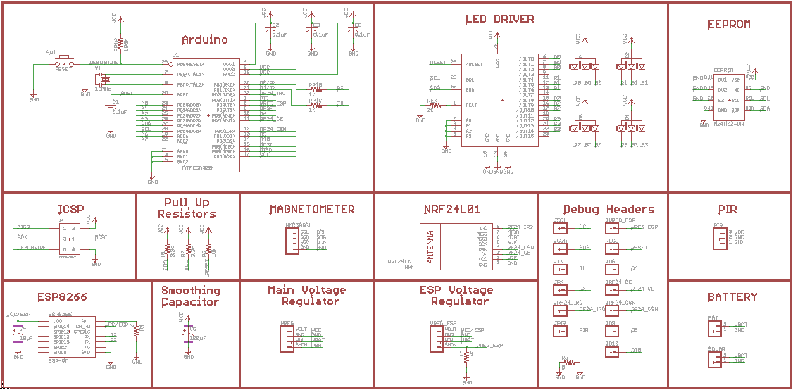
Master Schematic
Allows for organization and modulation
One schematic allows for the PCB to be condensed without extra add on boards.
All team members

Slide 39
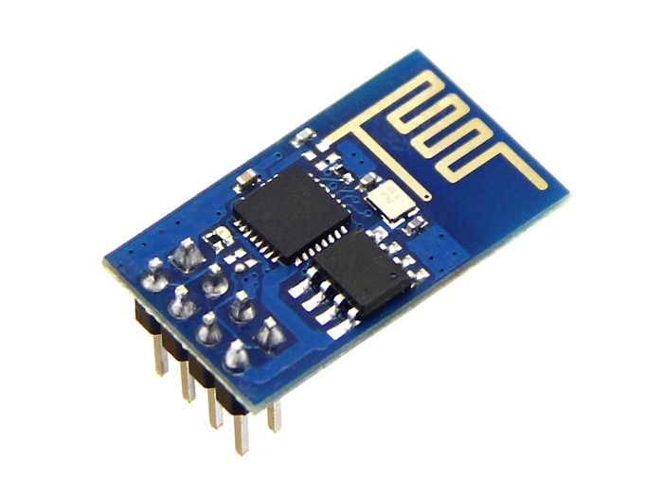
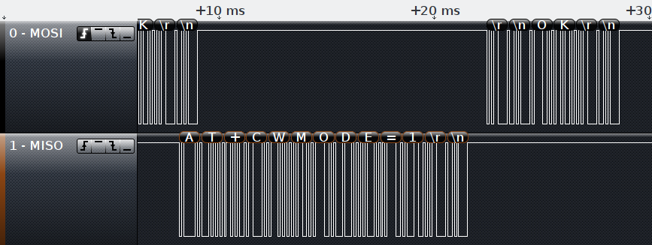
ESP8266
[5]
George and Preston
Notes:
http://www.ti.com/product/lm3670
Attach Matlab Graph
http://www.discovercircuits.com/DJ-Circuits/Modified_Solar_PathLight.htm

Slide 40
NRF24L01+
Packet header
(packet number,
packet type)
Payload
(Message<AnnounceSensors>)
Preston and George

